Slide 1
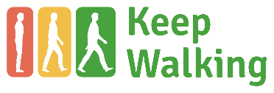

The Keep Walking Implant in vascular patients

Slide 2
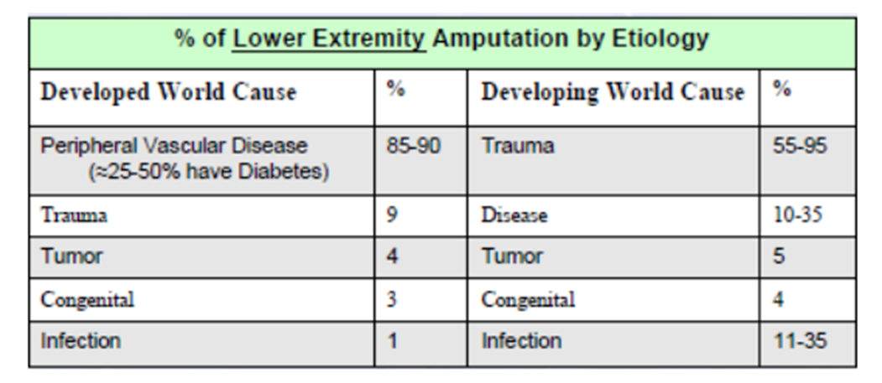
INTRODUCTION
In developed countries the major cause for amputation of the lower leg is a vascular disease
Witsø E, Lium A, Lydersen S. Lower limb amputations in Trondheim, Norway. Acta Orthopaedica. 2010

Slide 3
INTRODUCTION
A transfemoral amputation provokes physical changes associated with functional limitations:
  Gait changes
  Equilibrium changes
  Transfers changes*
  * Changing from one surface to another. Example: a patient who changes from his bed to a wheel- chair.
Specially at higher levels of amputation and in patients with comorbidities.
Haafner B. Differences in function-safety Medicare functional level 2-3 transfemoral amputees and influence of prosthetic knee.JRRD 2009

Slide 4
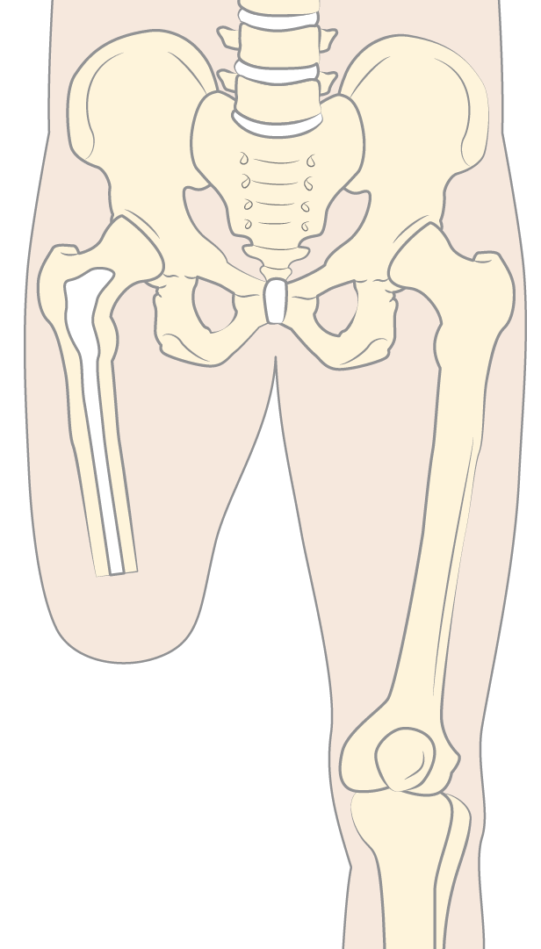
Problems associated with a transfemoral amputation
    1. Gait changes. Worse walking pattern
    2. Fatigue, due to extra effort
    3. Bad prosthesis control Almost no proprioception
    4. Volume changes, sweating, pain, skin irritation, instability within the socket
    5. Osteoporosis of the femur due to lack of mechanical stimulus
Notes:
Worse equilibrium and biomechanics provokes gait changes and can result in problems in other parts such as the spine and the contralateral hip.
Fatigue. Amputee patients have to make bigger efforts for the same result
Less control due to reduced muscles, a shorter leverage arm and body weight supported by unstable soft tissues.
Movement and or temperature changes cause volume changes, sweating, fitting problems and various skin issues. Ischium loads cause painful tender spots.
Fracture risk of the femoral neck increases due to the lack of charge stimuli in the bone that causes osteoporosis.

Slide 5
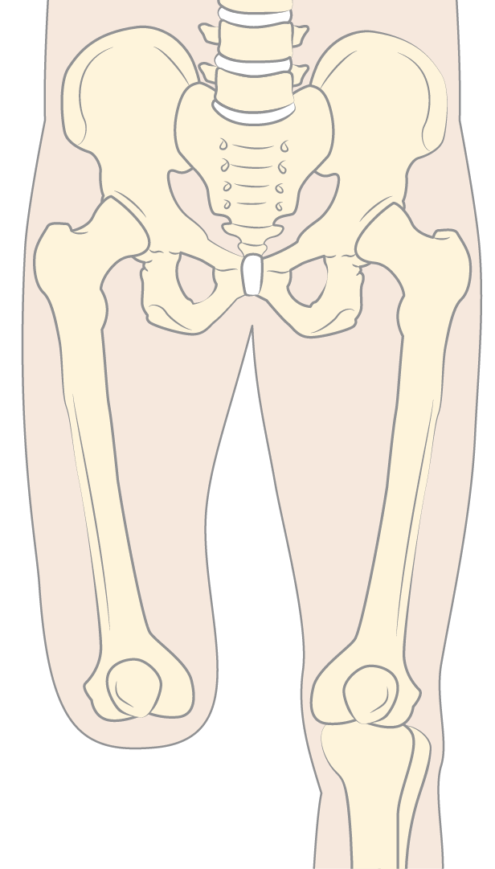
Benefits for the knee disarticulated in comparison with a transfemoral amputee
1. Permits distal weight bearing, less pressure on the ischium
2. Mobility of the hip is not restricted by a large socket
3. Better pressure distribution (due eight bearing)
4. Longer leverage arm and intact muscles.
5. No additional osteoporosis due to the lack of loads.
6. Proprioception
1
Notes:
Distal support of the stump makes a more comfortable distal weight bearing socket possible with less pressure on the ischium ramus. This results in mayor overall comfort.
The mobility of the hip is not restricted by a large ischium socket.
Better overall distribution of the pressures into the socket.
Longer leverage arm. Better control of the prosthesis.
The osteoporosis of the femur is stopped and/or reduced because the femur participates in the load transmission.
Natural proprioception improves prosthesis control.
The mayor “disadvantage” is an aesthetic one. When sitting the difference of thigh lengths becomes visible.

Slide 6
Objective
To offer a transfemoral amputee the aforementioned benefits of a knee
disarticulation by restoring the capacity to put their weight on the distal
part of the stump.
Notes:
The objective was to transform a TF amputation into a Through Knee amputation

Slide 7
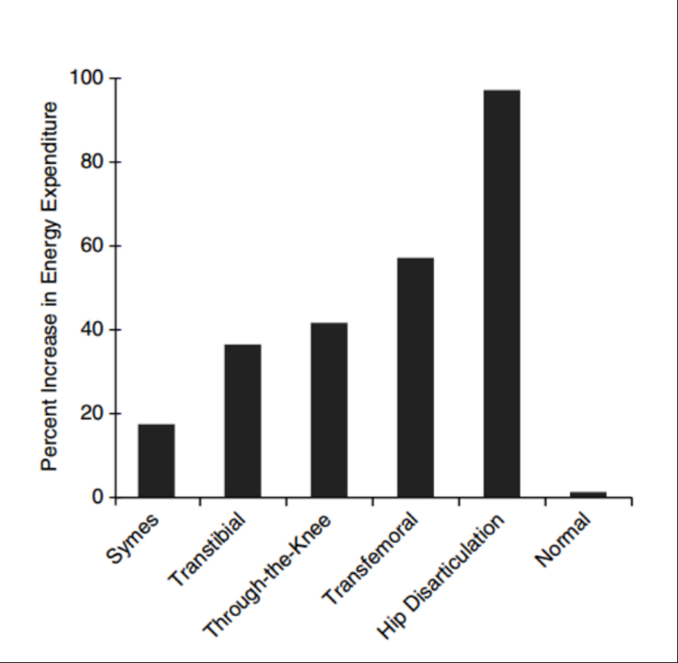
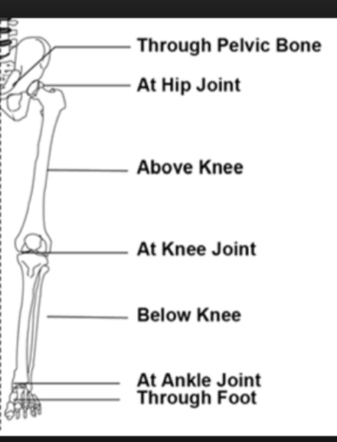
Objective: Energy cost
  ENERGY EXPENDITURE AND FUNCTIONALITY
Alberto Esquenazi MD, Robert DiGiacomo PT. “Rehabilitation after amputation” J Am Podiatr Med Assoc 91(1): 13-22, 2001
Notes:
There are different levels of amputation in the lower limb. From Symes (ankle amputation) to Hip dissarticulation. Every level has an extra energy cost expenditure. Through Knee amputation is closer to TransTibial amputation that to Transfemoral amputation

Slide 8
Objective: Energy cost
  ENERGY EXPENDITURE AND FUNCTIONALITY
Esquenazi A. Rehabilitation after amputation. Journal of American Podriatic Med 2001
Alberto Esquenazi MD, Robert DiGiacomo PT. “Rehabilitation after amputation” J Am Podiatr Med Assoc 91(1): 13-22, 2001
Notes:
There are different levels of amputation in the lower limb. From Symes (ankle amputation) to Hip dissarticulation. Every level has an extra energy cost expenditure. Through Knee amputation is closer to TransTibial amputation that to Transfemoral amputation. With the Keep Walking Implant for TransFemoral Amputees we tray to put the extra energy consumption closer to the Through knee amputation.

Slide 9
Objective: Energy cost
  ENERGY EXPENDITURE AND FUNCTIONALITY
Keep Walking
Esquenazi A. Rehabilitation after amputation. Journal of American Podriatic Med 2001
Notes:
There are different levels of amputation in the lower limb. From Symes (ankle amputation) to Hip dissarticulation. Every level has an extra energy cost expenditure. Through Knee amputation is closer to TransTibial amputation that to Transfemoral amputation. With the Keep Walking Implant for TransFemoral Amputees we tray to put the extra energy consumption closer to the Through knee amputation.

Slide 10
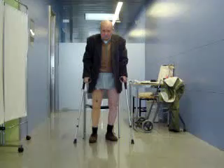
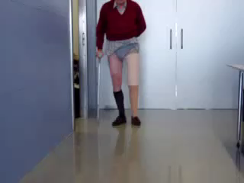
Objective
Notes:
This was the idea that led to the design of the implant. This is a vascular TransFemoral ampute patient. He walks with a lot of difficulty.

Slide 11
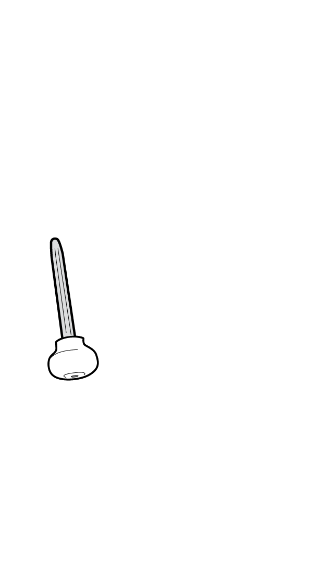
Method
A titanium stem anchored in the femoral medullary canal
A polyethylene spacer at the distal end of the femur, covered by the residuum’s soft tissues. This spacer restores the distal weight bearing capabilities of the femur
Notes:
A titanium osseointegrated stem, with a polyethylene weight bearing spacer, with an ample and rounded bearing surface for loading comfort.

Slide 12
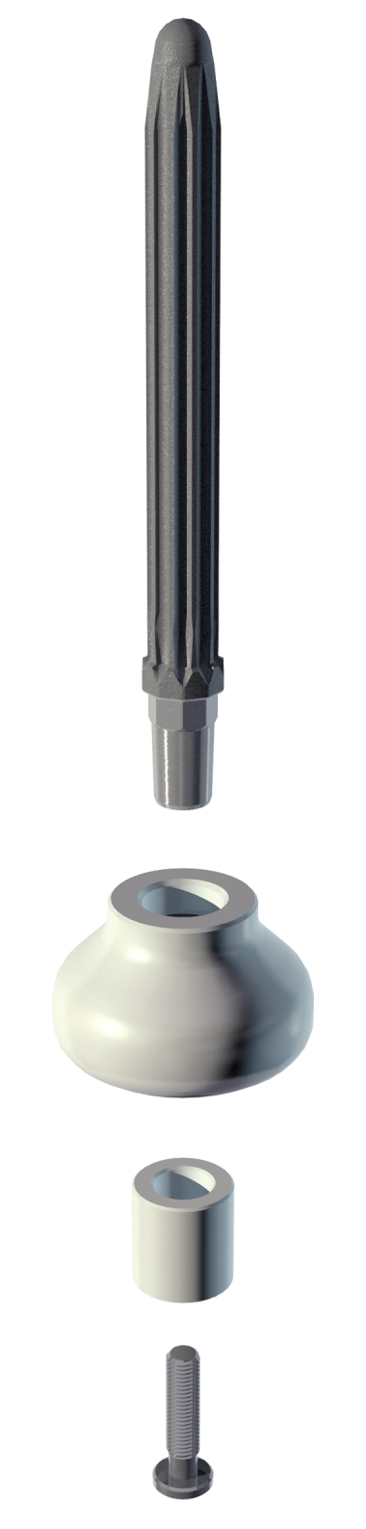
The Keep Walking
implant
Stem: titanium Ti6Al4V
4 lengths and 6 diameters
Spacer: UHMW polyethylene
3 sizes
Plug: UHMW polyethylene
Screw: titanium Ti6Al4V
Notes:
A stem with a rough surface for osteointegration and anti-rotational grooves.
Various diameters and lengths
Polyethylene cushion device for distal load in 3 different sizes
A screw for a firm unison of stem and cushion device and a plug for a flush surface.

Slide 13
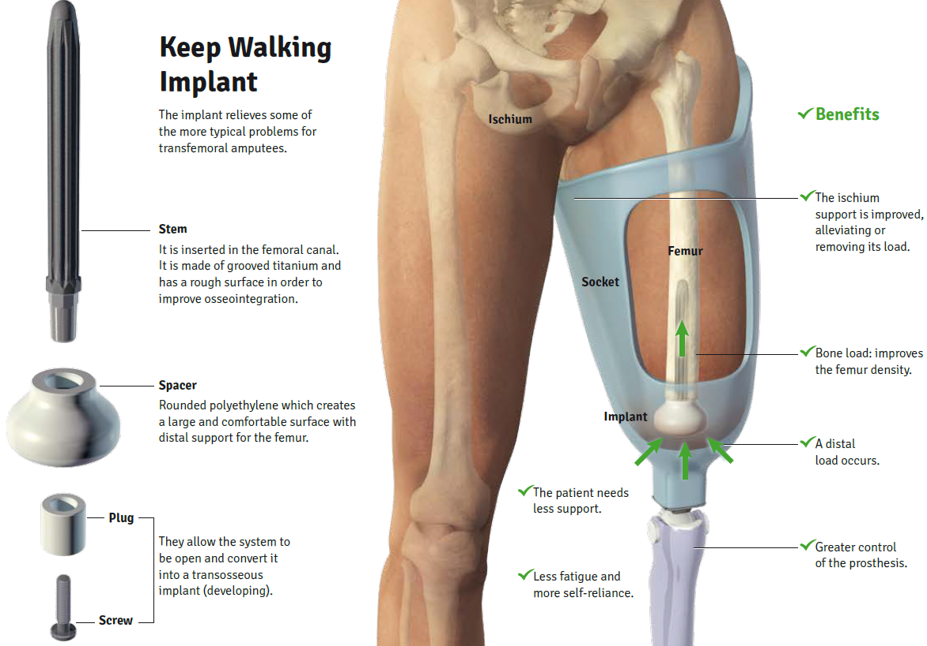
The Keep Walking
implant
Notes:
A titanium osseointegrated stem, with a polyethylene weight bearing spacer, with an ample and rounded bearing surface for loading comfort.

Slide 14
Characteristics/Benefits
• Valid for amputees of vascular, traumatic, congenital or oncologic etiology
• Permits distal weight bearing
• Transmits charges to the femur
• Permits the use of a more comfortable socket with more hip range
• Permits walking with less or no technical aids
Notes:
The KeepWalking implant is a 100% ENDO implant. This means that it can include patients with vascular origin who are deemed fit enough to be candidate for a prosthetic leg.
The return of distal load permits a more comfortable external socket with less or hardly any ischium loads, a wider hip range, more comfortable sitting, less pain and more proprioception as well as better control of the external prosthesis.
The socket can also feature windows which relieve sweating problems, as well as pressure problems caused by volume changes of the stump.

Slide 15
Knee Disarticulated
benefits
KW implant
features
1. Permits distal weight bearing, less pressure on the ischium
2. Mobility of the hip is not restricted by a large socket
3. Better pressure distribution (distal weight bearing)
4. a) Longer leverage arm, and b) intact muscles.
5. No additional osteoporosis due to the lack of loads.
6. Proprioception
Yes
2. Yes
3. Yes
4. a) Improved b) No
5. Yes
6. Yes
Notes:
These are the “benefits” of the Through Knee amputation compared with the KW Implant amputation
Both solutions allow for distal weight bearing
Adapted distal load socket permits more hip range of motion
Both solutions have better pressure distribution (because of the distal weight bearing)
Longer leverage arm because with the KW you take more advantage of the total length of the stump/femur.
Osteoporosis of the femur is reduced because now it participates in the load distribution.
Better proprioception. The patient feels when the lower prosthesis touches the ground.

Slide 16
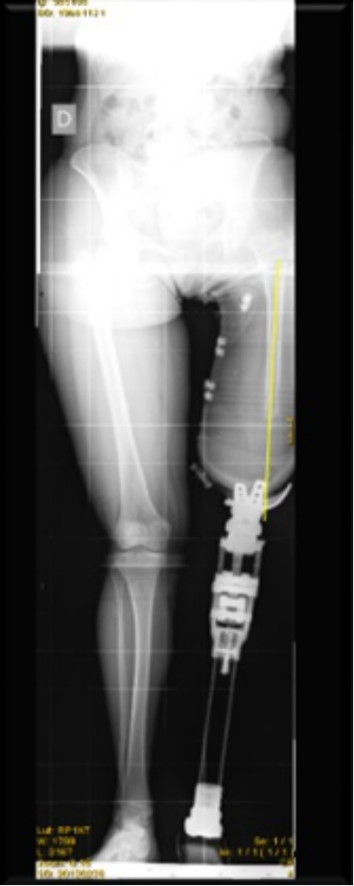
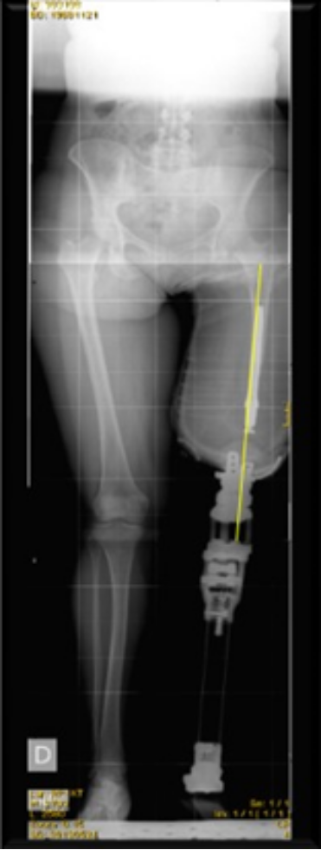
Femur axialization
Before
After
Notes:
Another positive effect of the implant is the axialization of the femur within the stump due to the bulbous shape of the spacer, in combination with a socket that takes this feature into account.

Slide 17
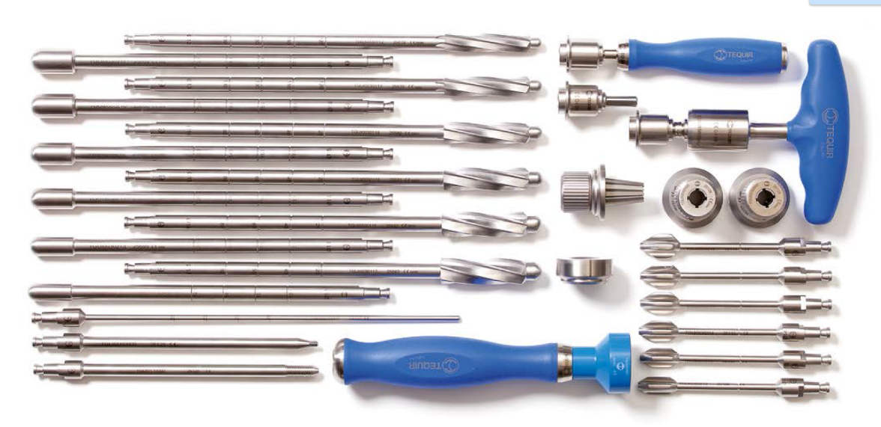
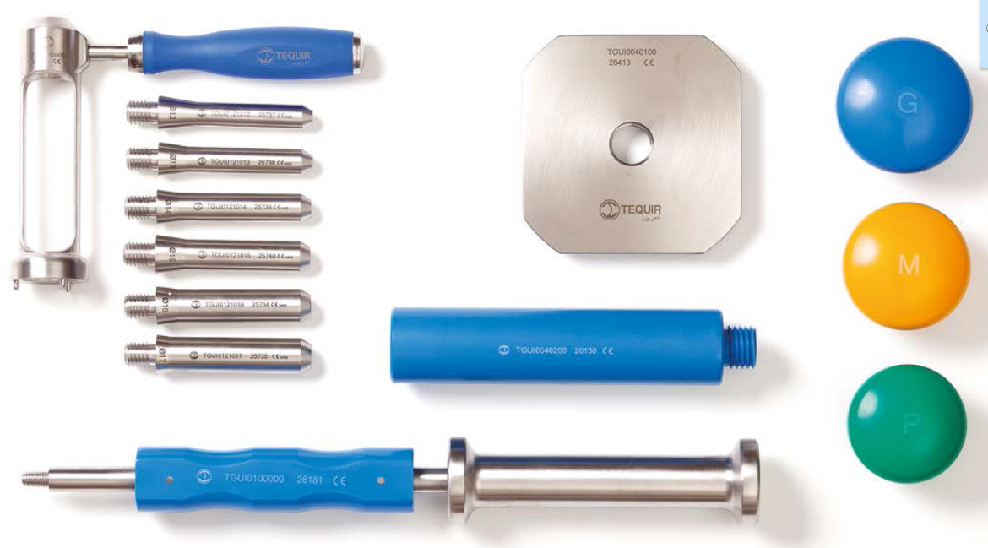
Surgical technique
Instrumentation
Notes:
Surgical Technique: Instrumentation in 2 cases. Standard instrumentation for an orthopedic surgeon (measuring, cutting, reaming, trial, implant)

Slide 18
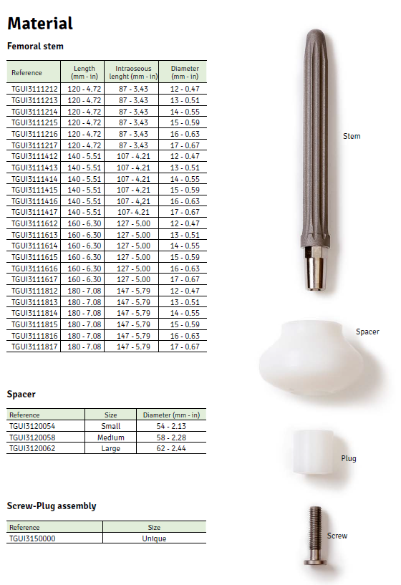
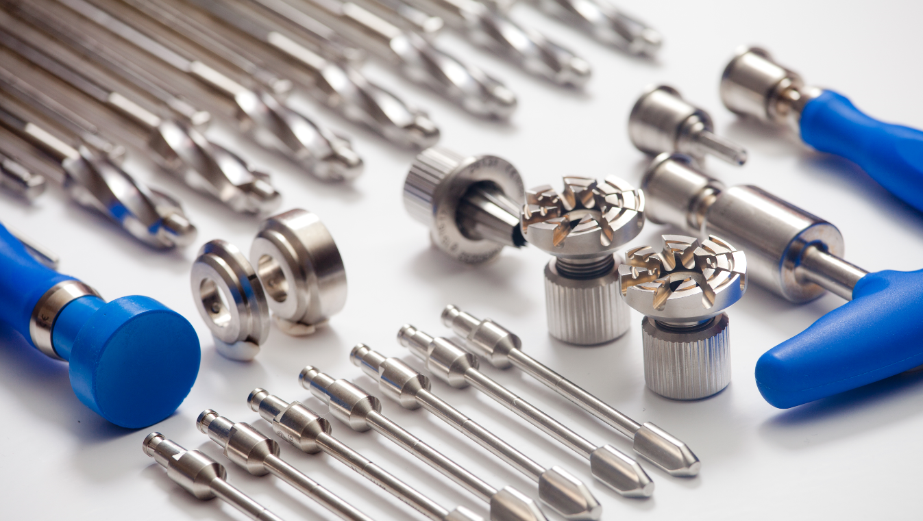
Surgical technique
Implants
Notes:
Surgical Technique: Implants. Stem in 4 lengths and 6 diameters. 3 sizes for the polyethylene spacer and 1 for the screw/washer

Slide 19
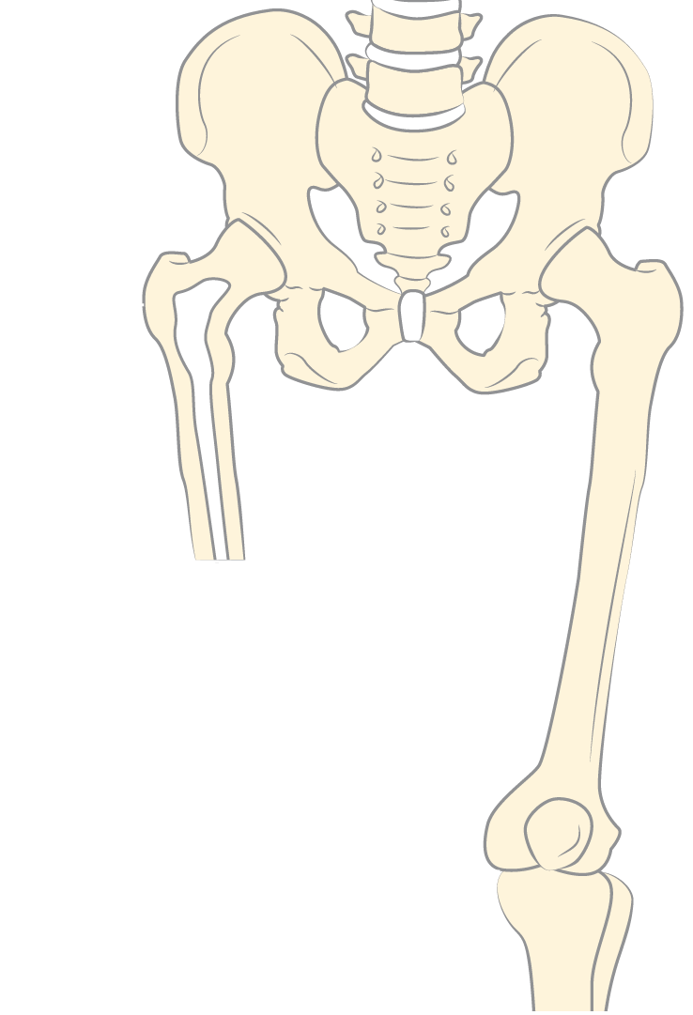
Surgical Technique
Preoperative Planning
1. Residual length of the femur more than 14 cm
2. Diameter of the femoral canal
3. State of the cortical bone, possible bony spikes, etc.
1
3
2
Notes:
1. Measure the residual femur length. More than 12-13 cm as from the greater trochanter (now we have shorter stems)
2. Diameter of the implants 12 - 17 mm
3. Evaluate the state of the cortical bone, remove possible bony spikes, etc.

Slide 20
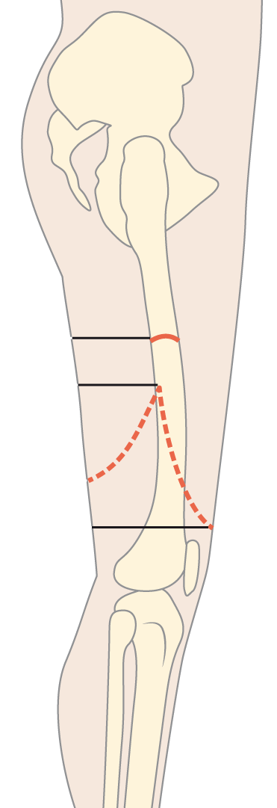
Fish mouth incision
With already amputated
patients the old scar is used.
4 cm
4-5 cm
Notes:
Fish mouth incision: posterior flap 4 -5 cm more proximate than anterior flap. The cross point of the flaps should remain 4 cm distal of the level of the femoral cut, in order to leave enough space for the polyethylene spacer (40 mm thick). So, the thing is that soft tissues are needed in order to perform a good coverage the spacer.

Slide 21
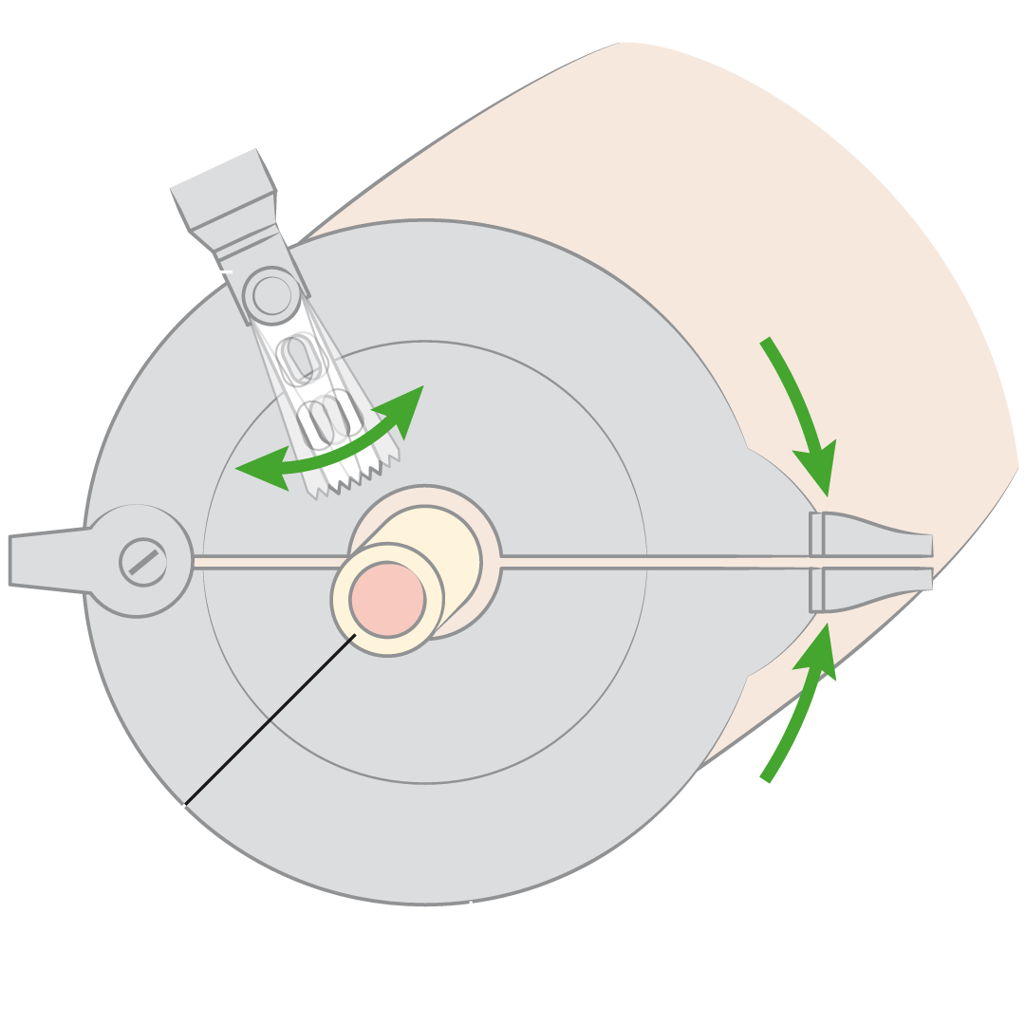
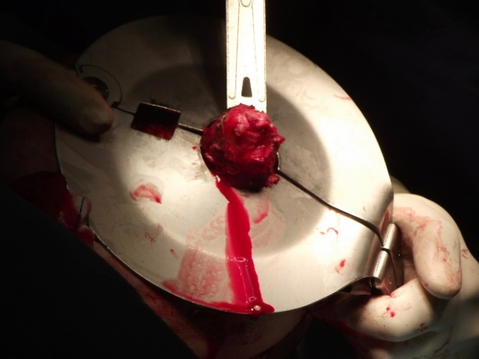
Cutting the femoral end
Thigh
Oscillating saw
Femur
Soft tissues retractor
Notes:
In already amputated patients (delayed implantation) ,between 2 and 4 cm of the distal femoral bone has to be cut, in order to make enough space for the polyethylene spacer in such way that polyetilene spacer can be covered (without tension) by soft tissue. .

Slide 22
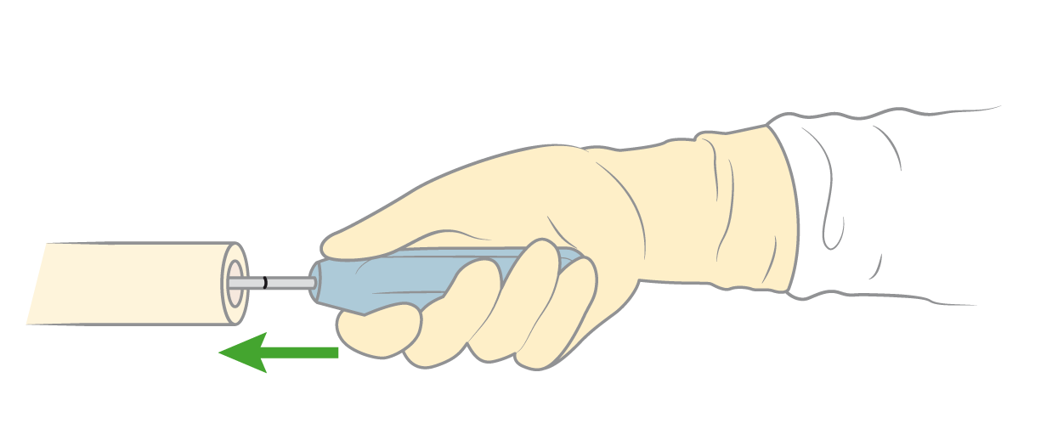
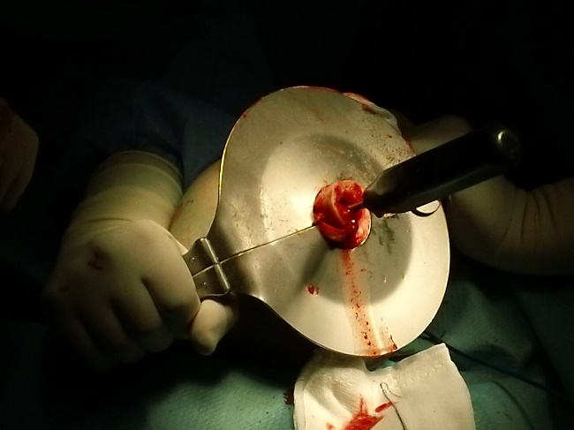
Verifying the diameter and depth of the femoral canal
Femur
Notes:
The tip of the measure instrument should be touching the trochanter area to give the right stem length. The last mark inside the femur is the MAXIMUN length to be implanted, but usually is not necessary to go to the maximum length.

Slide 23
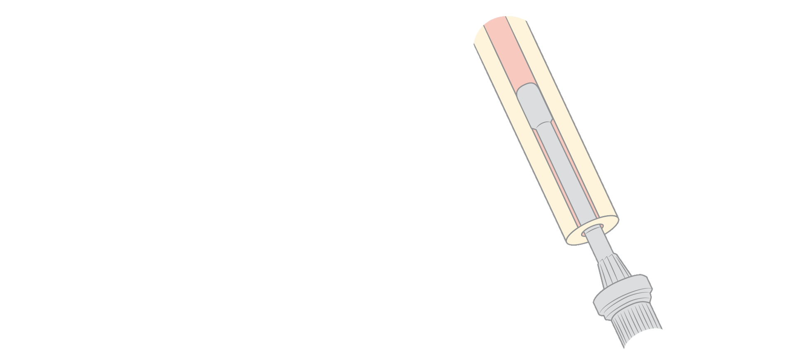
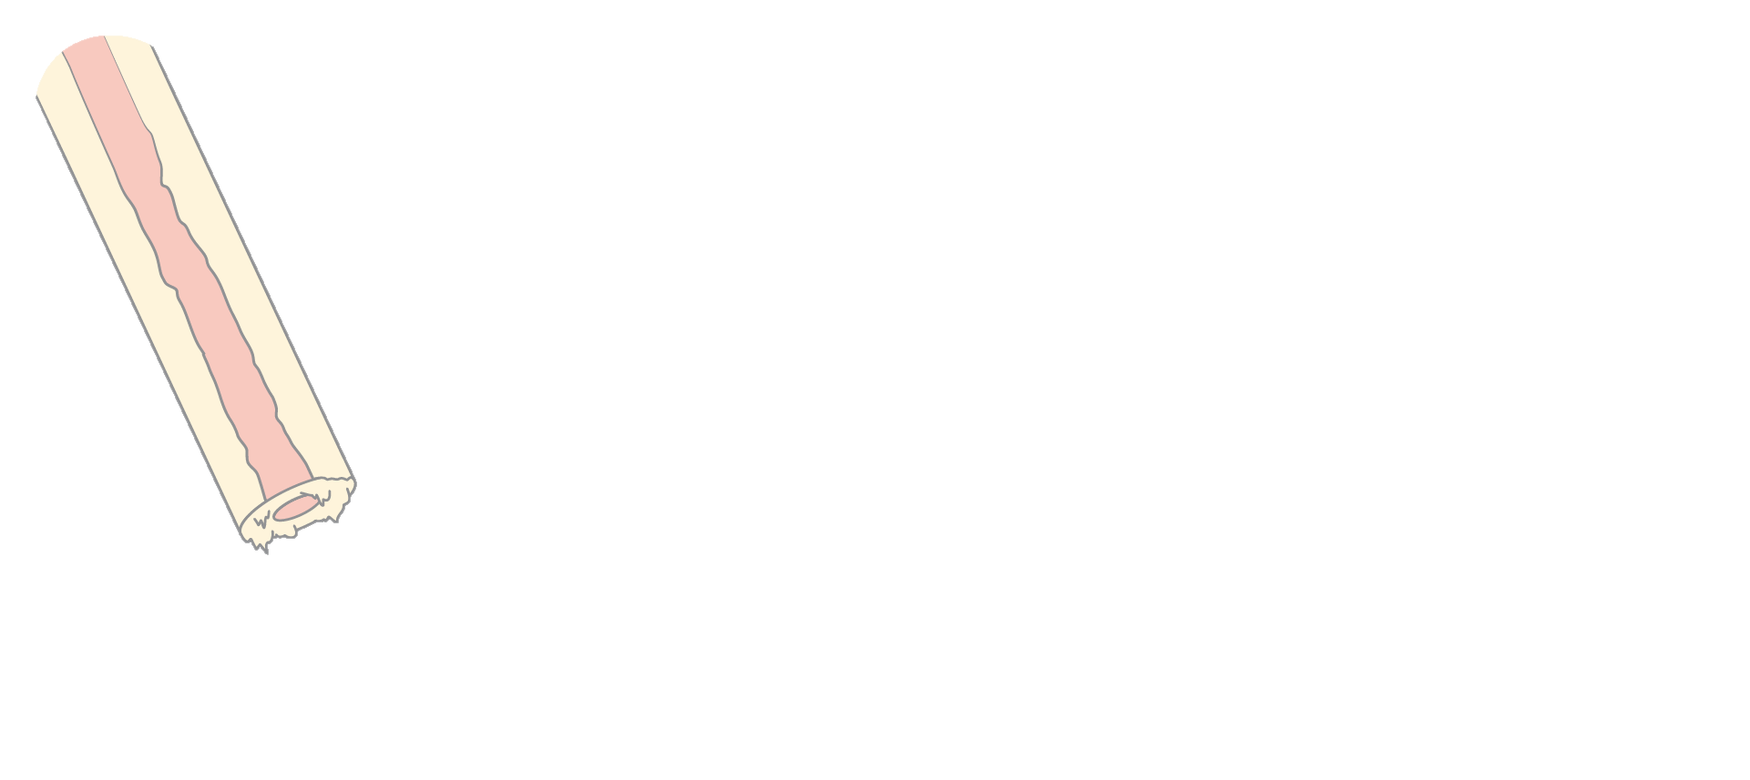
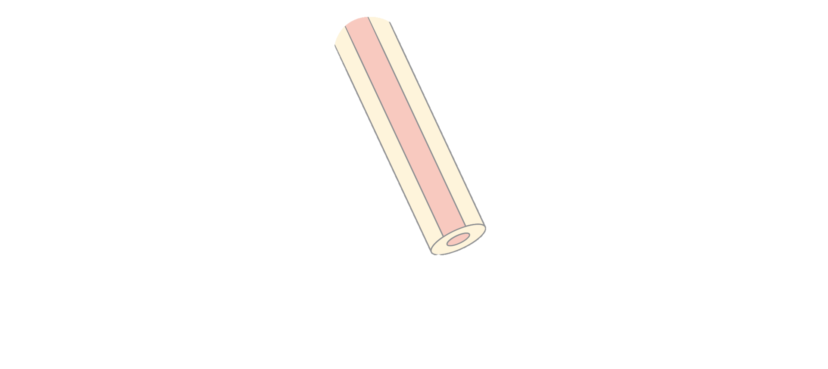
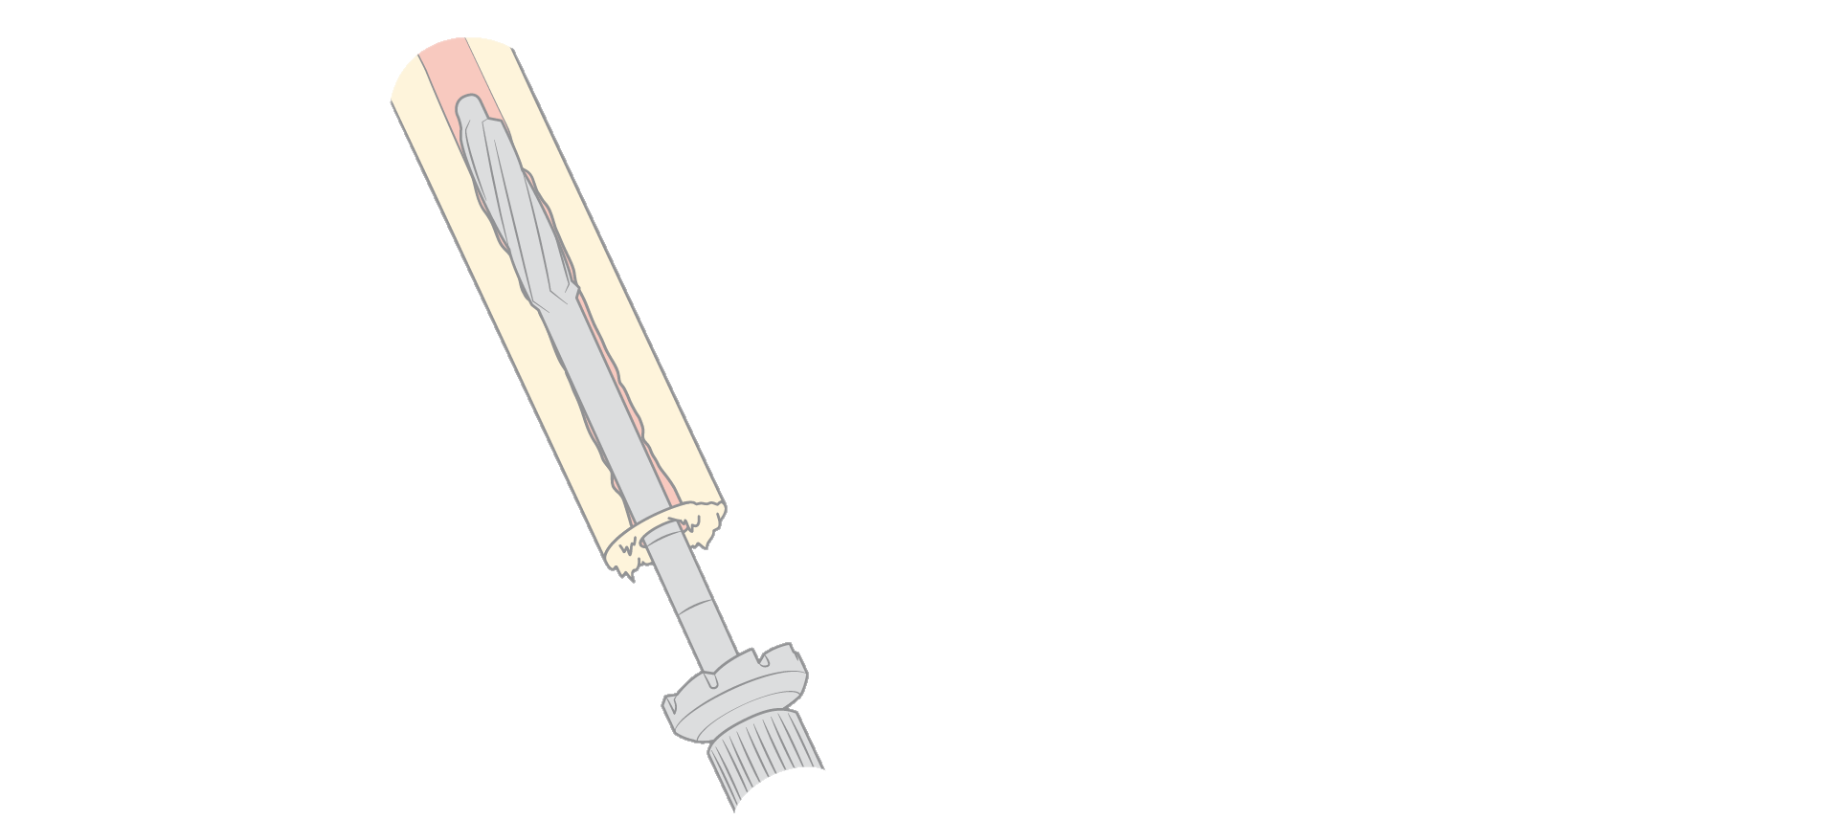
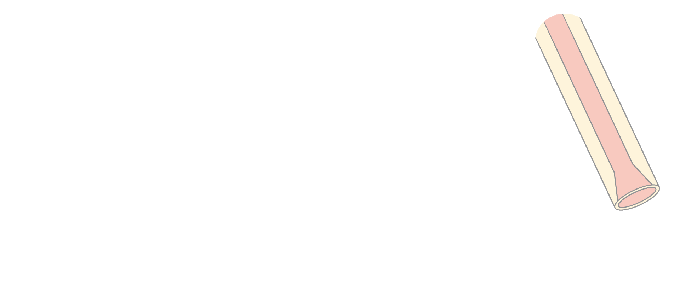
Femoral reaming
1. Medullar reamer
3. Reamer guide
2. Flat frontal reamer
4. Conical reamer
1
3
2
4
Femur
Notes:
Progressive reaming until the selected diameter. Each ream has a flat reamer attached, in order to set the lenght of the reaming and smooth the distal end of the femur. Finally, a conical bur is used.

Slide 24
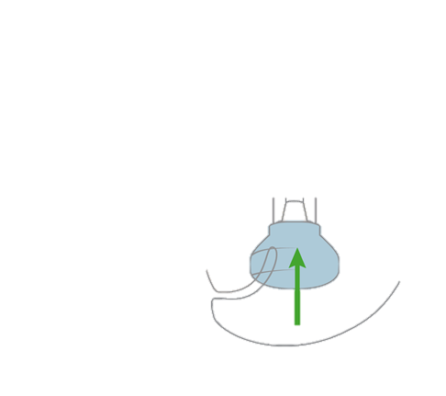
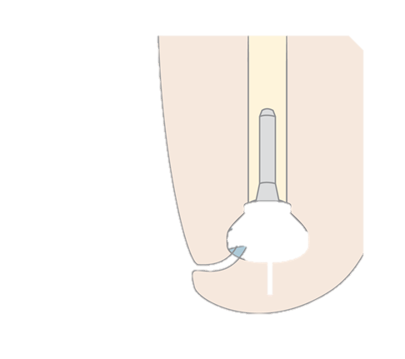
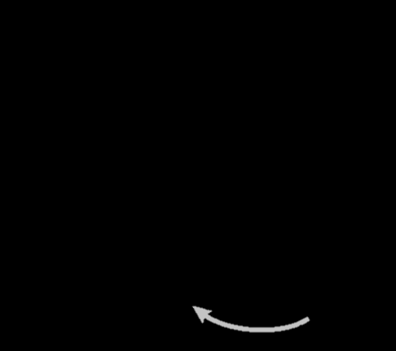
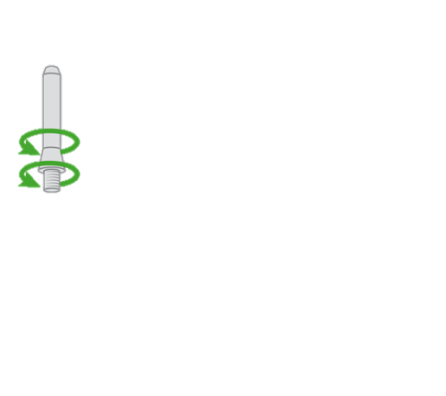
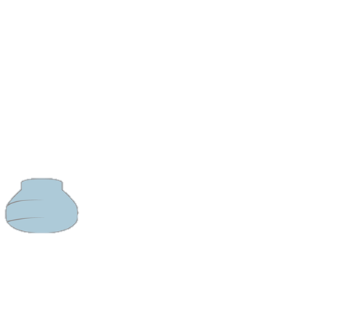
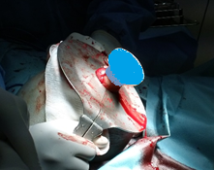
Selection of the spacer
Trial stem
Trial spacer
Select the biggest possible spacer, permitting a closure without tension, taking care
not to leave too much distal soft tissue for better prosthesis control.
Notes:
All the spacers have the same length (40 mm), but different diameter (54-58-62 mm). The tip for selecting the right spacer is to use the biggest one that allows a closure of the soft tissues without tension.

Slide 25
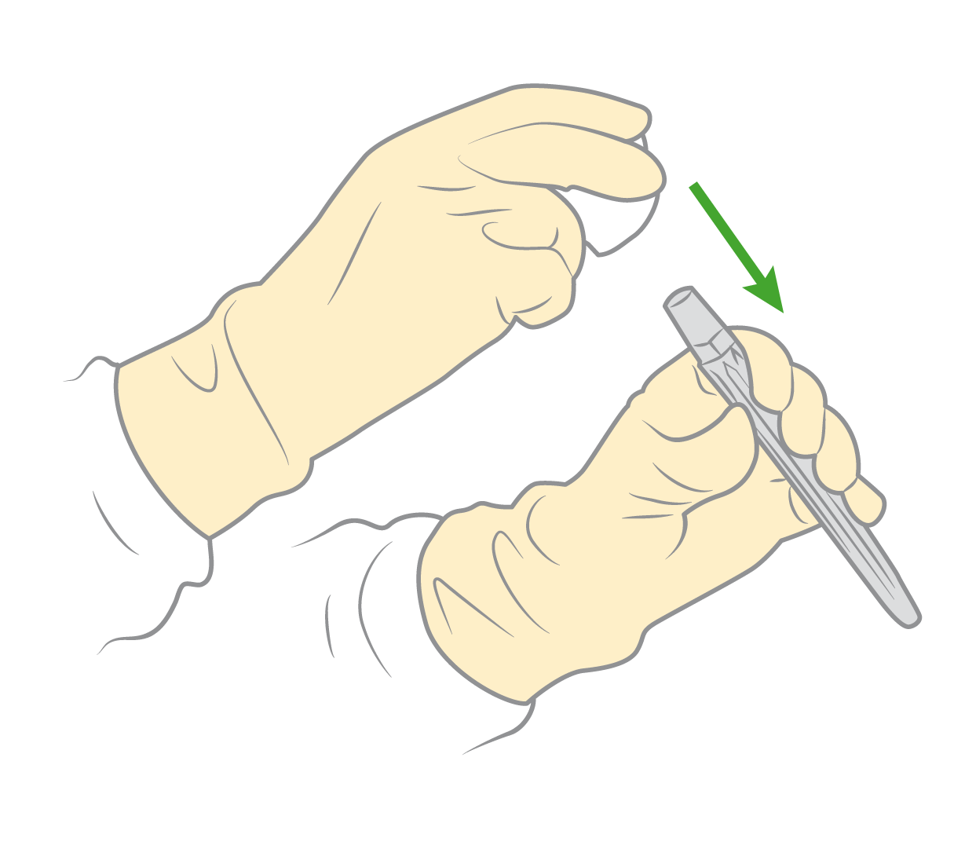
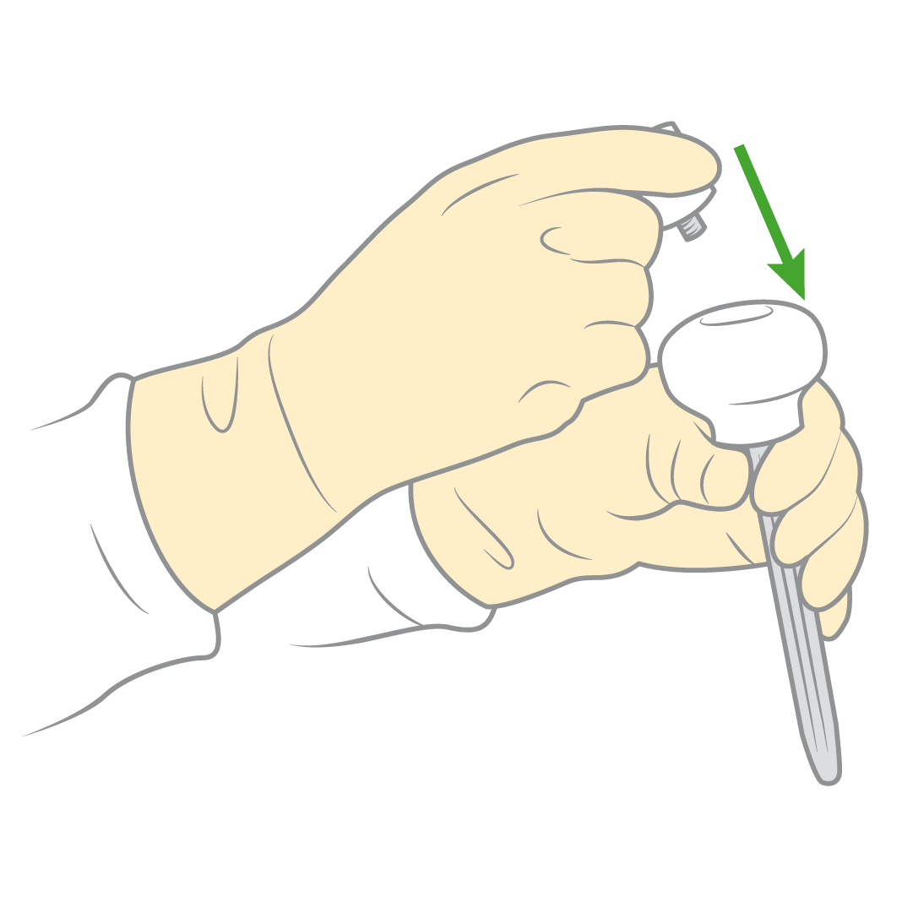
Preparing the implant
Spacer
Screw/plug
Stem

Slide 26
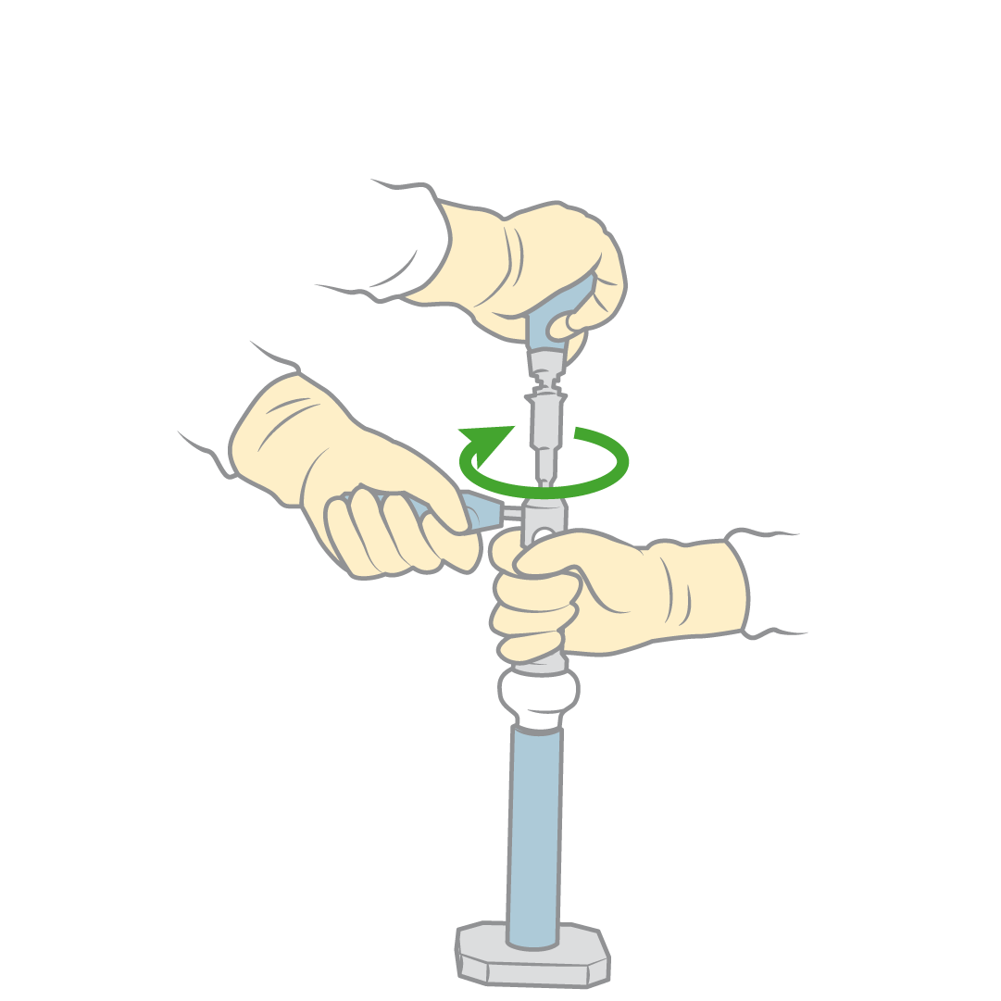
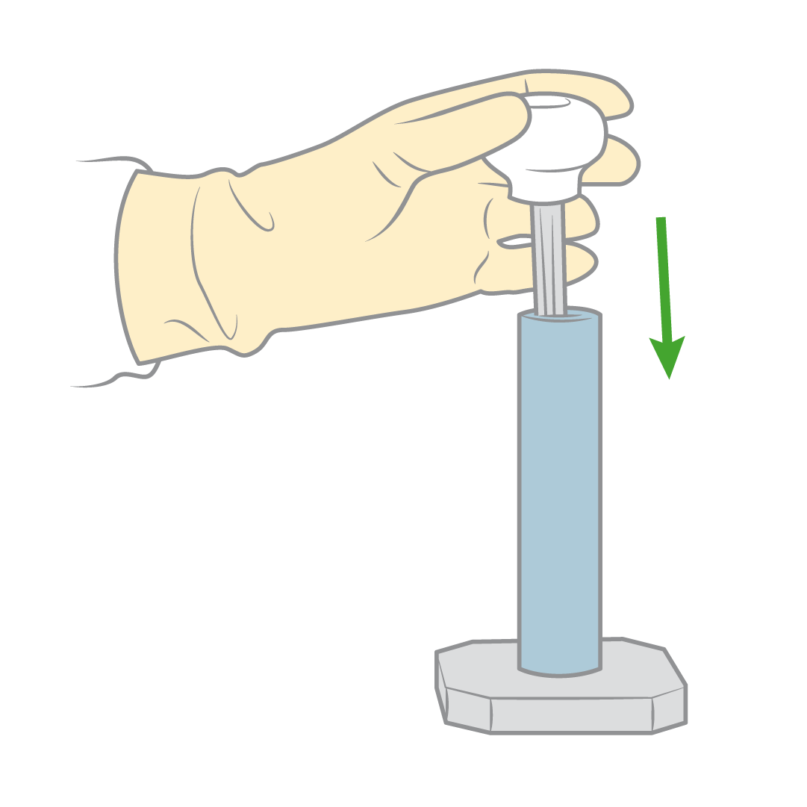
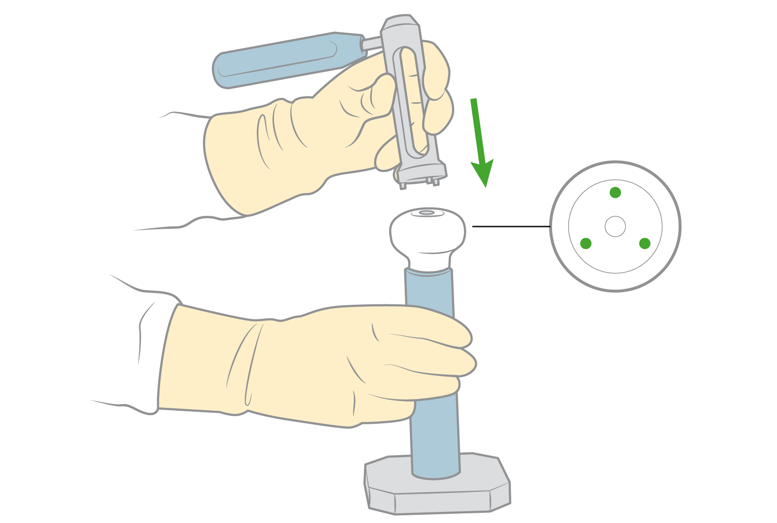
Preparing the implant
Anti-rotation guide
Force: 5 N.m.

Slide 27
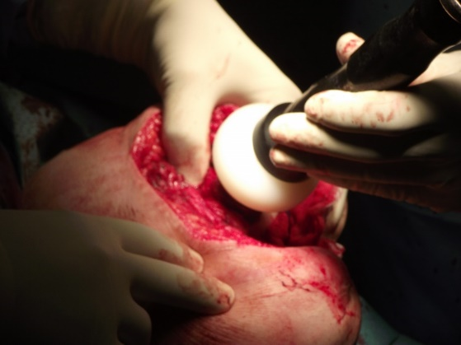
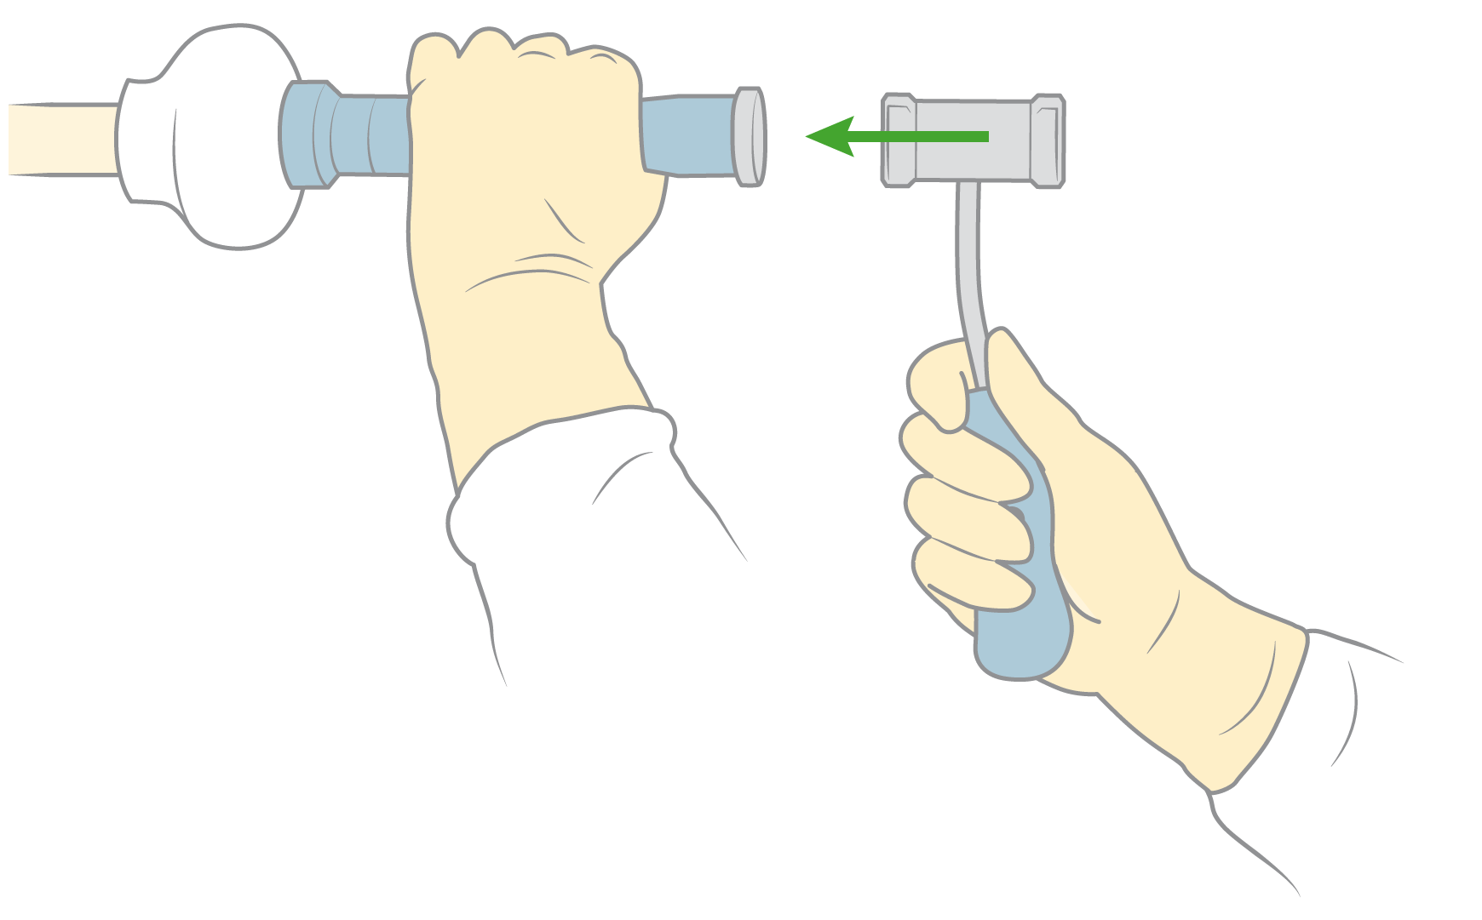
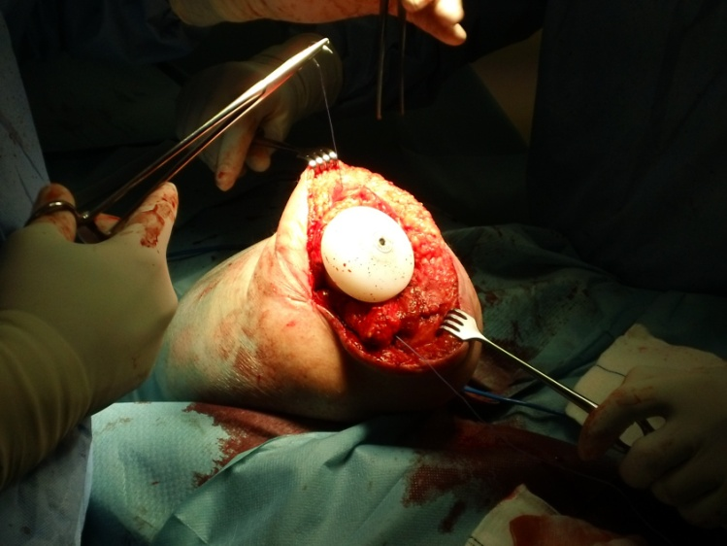
Press-Fit technique
90º
Notes:
Impactación a press-fit
Closure by planes.
Take care not to cover the spacer with an excess of soft tissues which can lead to a “pudding” stump (hard to control by the patient)
The whole “implant” has to be covered.

Slide 28
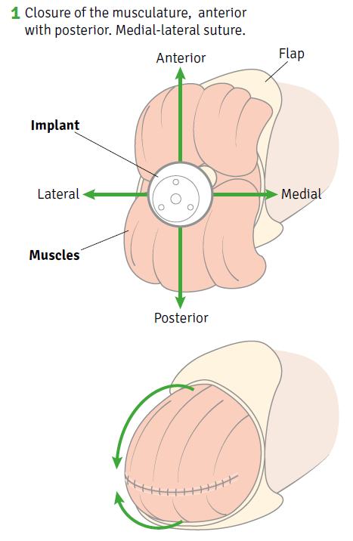
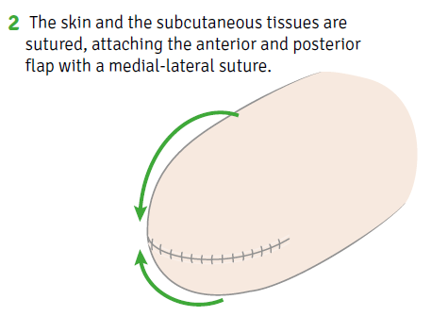
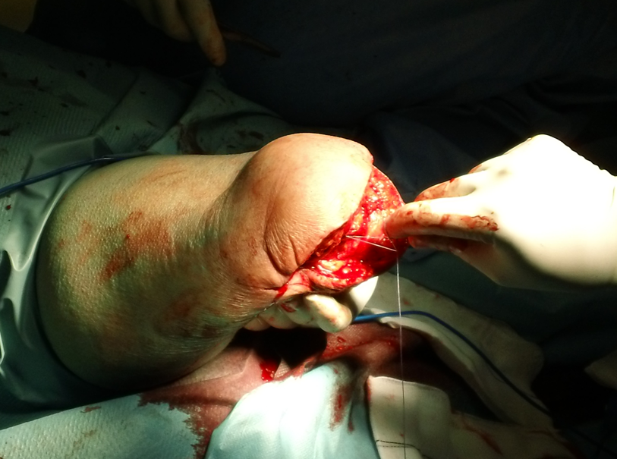
Myoplasty and closure
Notes:
Impactación a press-fit
Closure by planes.
Take care not to cover the spacer with an excess of soft tissues which can lead to a “pudding” stump (hard to control by the patient)
The whole “implant” has to be covered.

Slide 29
Surgical Technique
SUMMARY
Specific and intuitive instrumentation
Both early and delayed implantation
Affordable surgical technique
Short learning curve
Procedure takes only 15-20 extra minutes (in early implantation)

Slide 30
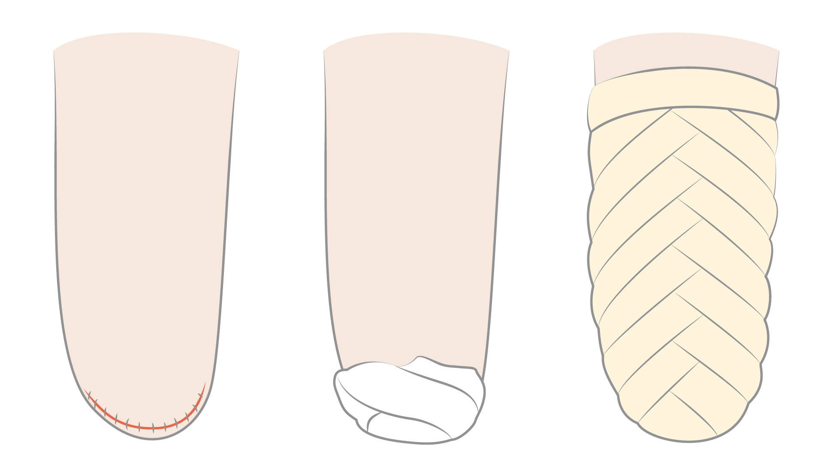
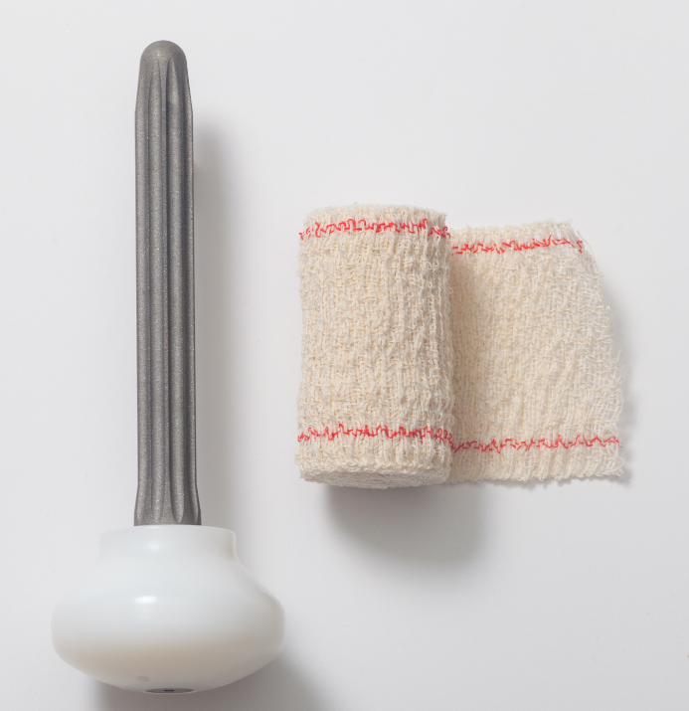
‘Herringbone’ type bandage
Notes:
Standard bandage for a TF amputation

Slide 31
Postsurgical radiologic control

Slide 32
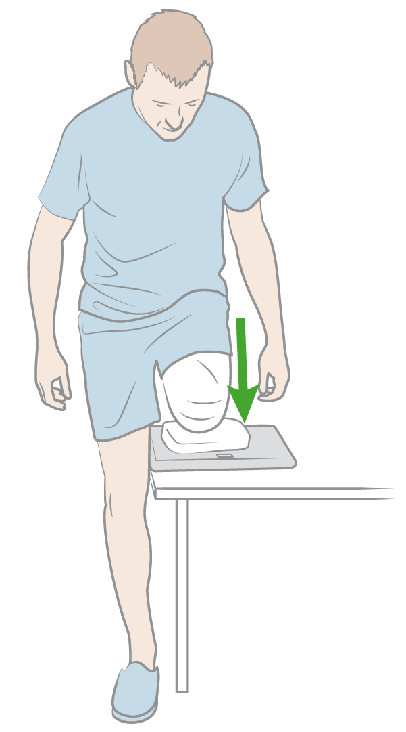
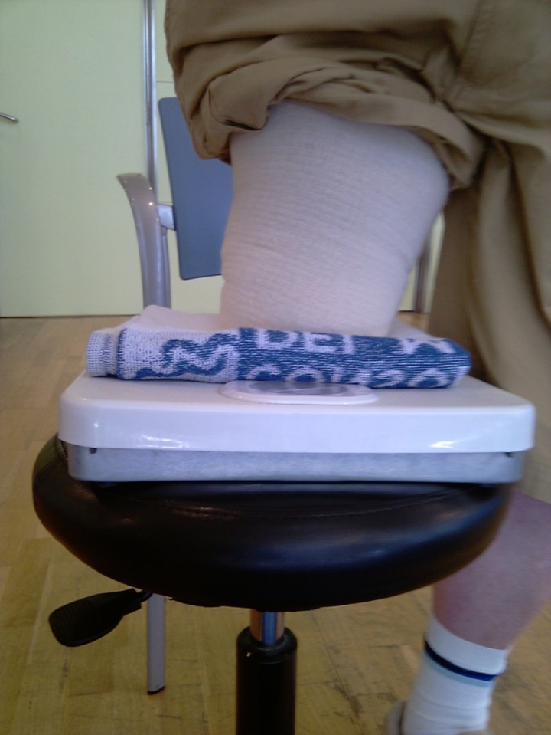
Rehabilitation
• Standard protocol for femoral amputation
• Progressive load on a weight scale, from 5 to 20/25 kg
Notes:
In our study, the rehabilitation protocol was strictly standard.
The only difference with the standard protocol were the progressive load exercises.
We began the progressive distal load on the residuum with 5 kg, increasing up to 25 kg during the first 4 weeks
The progréssive distal load on the residuum was started after the first week with 5 Kg (kilos), increasing up to 25-30 Kg for fourth weeks

Slide 33
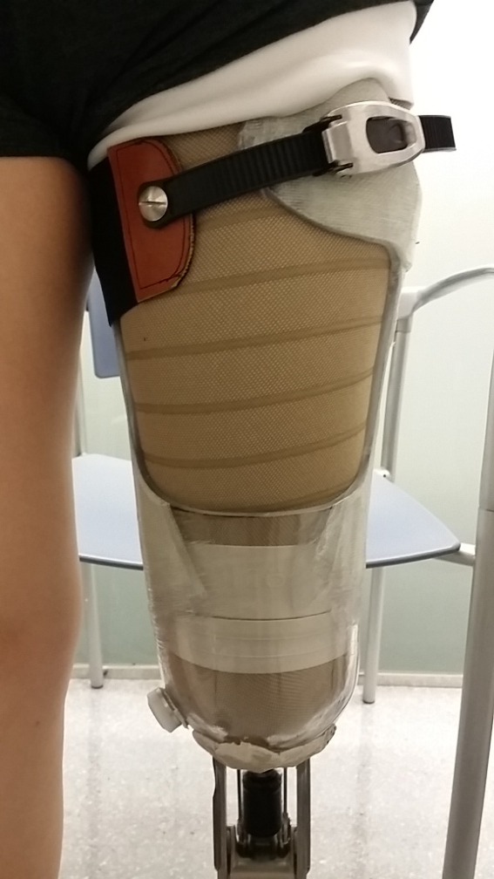


Rehabilitation schedule
Rehabilitation
Prosthetic Schedule
7 – 10 days
Healings
3 – 5 weeks
3 months
4 – 6 weeks
Progressive weight
bearing
Gait training
Surgery
Distal load
(training)
Provisional Socket
(Distal load)
Final Socket
(distal load)
Notes:
The Rehabilitation phase begins 7-10 days after surgery, when sutures have been removed. At this moment we can start start with the progressive distal load (25 kg in 4 weeks) Between 4-6 weeks the stump is usually prepared for a provisional socket (with partial distal load) and prosthesis fixation, after that the amputee begins gait re-training, and around 3 months later the definitive socket can be made (with maximum distal load)

Slide 34

Routine control at 2 and 4 months

Slide 35

Ultrasonography control
Notes:
In the clinical trial we performed a Ultrasonography in all the patients in order to ensure that the mioplasty remains after time.

Slide 36

Ultrasonography control
Notes:
In all of them, the mioplasty remains. An atrophy is usually observed (muscle layer becomes thinner), but remains on site.

Slide 37


KW stump (video)
Notes:
En este video podemos observar cual es el muñón tipo que se consigue con el implante KW. Firme y compacto

Slide 38

Muñón KW (video)
Notes:
En este video vemos la evolución de un paciente desde el momento de la intervención hasta 2 meses después de la misma, donde observamos que el paciente puede cargar el 100% de su peso sobre el muñón.

Slide 39


Residuum
Notes:
After some months, the residduum use to take the shape of the implant, specially in men. This has no trascendence, but sometimes a thicker liner has to be used.

Slide 40



Rehabilitation: the socket
Provisional Socket
Final Socket
Notes:
Ussually we are asked: what kind or socket do you use with the Keep Walking Implant? No specific socket is used. It depends on the patient and on the P&O technician. But the difference is that the prosthetic technician can take advantage of the distal load.
This Is a picture of the provisional socket (2 on the left). And this one is the picture of a final socket (right)when the residuum (residuum) volume is stabilized. Ussually at three months
40

Slide 41


Rehabilitation: the socket
Notes:
As mentioned, the skills and the imagination of the prosthetic technician are very important. F.e. Elastic back bands can be used in some patients.
41

Slide 42


Rehabilitation: the socket
Notes:
Different examples on the socked. In general, Windows can be opened and the back part of the socket use to be in soft material (better for sitting, driving, etc)
42

Slide 43


Rehabilitation: the socket

Slide 44


Rehabilitation: the socket
Notes:
Sub isquial support socked are also posible.
44

Slide 45

Cases
Notes:
This is one of the cases, from pre-surgical Rx, planning and to post-op Rx

Slide 46

Cases
Notes:
Another case

Slide 47


Cases

Slide 48
Cases
Telemetria de sagasti

Slide 49


Notes:
A Keep Walking patient.

Slide 50



Scientific papers
Notes:
5 Articles that have been pusblished

Slide 51


Scientific papers
Notes:
4 Articles that have been pusblished

Slide 52


Scientific papers

Slide 53
Clinical Trial
• Experimental prospective non randomized study of the type before-after
Subjects amputated at least 1 year previous to the Keep Walking Implant, for subjective feedback
• Follow-up 14 months post-implantation
Performed at 5 hospitals
No change in hardware (except for the socket)
• KW has been implanted in 29 patients
23 patients finished the study
Notes:
Subjects amputated at least 1 year previous to the Keep Walking Implant, for subjective feedback: Patients had to be users of an external prosthetic leg, at least, one year prior to the Keep Walking surgery. In this way, the patient could be his own control.
6 patients abandoned the study. 3 for SECONDARY infection after secondary surgery (1 bone spikes not completely removed during the KW surgery and two neuromas), two had a severe osteopenia and no osseointegration was achieved, and one patient had a problem in the contralateral led that made it impossible to perform the tests.
ALL these patients returned to their previous functional level after the Keep Walking Implant explantation

Slide 54
Sample Characteristics
VARIABLE | N 23
Mean time after amputation | 95,71 months
SIDE
Right | 12 (52,2 %)
Left | 11 (47,8 %)
ETIOLOGY
Traumatic | 10 (43,44 %)
Vascular | 9 (39,1 %)
Tumoral | 4 (17,46 %)
AMPUTATION LEVEL
Mid third | 18 (94,7 %)
Distal third | 2 (5,3 %)
Proximal third | 3
MEAN TIME OF PROSTHESIS USE | 81,84 months
Nr. of daily hours prosthesis use | 10,47 hours/day
FUNCTIONAL LEVEL
K2 | 6 (26,1%)
K3 | 17 (73,9%)
WALKING CAPACITY
Independent | 9 (39,1 %)
Walking stick | 6 (26,1 %)
1 Crutch | 4 (17,4 %)
2 Crutches | 4 (17,4 %)

Slide 55
Sample Characteristics
VARIABLE | N 23
Age | 51,63 +/- 16,7
SEX
Male | 18 (78,3 %)
Female | 5 (21,7 %)
Weight | 67,6 ± 12,8
Height | 166,3 ± 10,8
BMI | 24,4 ± 5,9
SOCIAL SITUATION
institutionalized | 1 (4,3 %)
With family | 6 (26 %)
With partner | 13 (56,5 %)
single | 3 (13,2 %)
Level of physical activity
Professional | 0 (0 %)
Intensive | 1 (4,3 %)
Sometimes | 6 (26,1 %)
Never | 16 (69,7 %)
COMORBIDITY 8 (53,3%)
Cardiovascular | 8 (42,1 %)
Nervous | 2 (10,5 %)
Endocrine | 5 (26,3 %)
Respiratory | 3 (15,8 %)
Muscle skeletal | 4 (21 %)
Notes:
4

Slide 56
Summary of Results
VARIABLE N=23 | INITIAL VALUE | VALUE AFTER 14 MONTHS | P value
2 minutes distance covered | 103.61 | 128,04 | 0,000
Velocity (m/min) | 51,805 | 64,02 | 0,000
VAS pain scale | 2.74 | 0,35 | 0,001
Daily hours of prosthesis use | 10,7 | 12,87 | 0,001
Oxygen consumption | 18,377 | 20,077 | 0,043
BMD Femoral Neck | 0,61274 | 0,687479 | 0,171
BMD Ward Triangle | 0,505 | 0,497 | 0,619
PCI (Physiological cost index = ∆ heart rate/walking speed) | 0,549 | 0,473 | 0,297
LCI scale (locomotive capacity index) | 38,4 | 39,9 | 0,194
HOUGHTON scale | 9,60 | 9,80 | 0,477
SAT-PRO scale (comfort) | 26,4 | 27,13 | 0,809
+23,60%
+23,60%
-87,20%
+20,20%
Notes:
The main variable was the 2MWT and there were several secondary variables (Vas pain score, Number of hours of use the prosthesis, O2 consumption, etc)
The variables that had a statistical significance difference between the PRE and the POST were Distance and speed, VAS pain, hours of use.
O2 consumption was statistically significant in the vascular patients group
Bone Mineral Density was not statistically significant but we found very promising the slight increase in the BMD in the femoral neck, as the follow up was only 14 months.
PCI = ∆ heart rate / speed
LCI & Houghton are patient questionnaires.

Slide 57

Principal results in graphics (N=23)

Slide 58
VELOCITY AND DISTANCE
(2 minutes)
∆ 23,6 %
∆ 23,6%
Walking speed (m/min.)
Distance (m after 2 min.)

Slide 59
VAS PAIN SCORE
𝛁 87,2 %
Notes:
Distal load permits reduction of pain to a level of minor discomfort

Slide 60
DAILY PROSTHESIS USE
∆ 20,2 %
Before After
Notes:
Reduced pain or discomfort augments daily use of the prosthesis by an average of 2-3 hours

Slide 61
HEART RATE
At rest
After 2 minutes walking
Indicates general health improvement
Notes:
Numbers indicate a general improvement of physical condition after 14 months

Slide 62
PCI = ∆heart rate/walking speed

Slide 63
BONE MINERAL DENSITY
∆ 10,1 % *
∇ 1,58 %
* A welcome secondary effect of distal load bearing, reduces the risk of
dangerous femoral neck fractures after a fall.
Notes:
Full distal load only after 3 months post surgical
Although the improvement in BMD is not statistically significant, we feel it as a very promising effect. The 14 months follow up is, probably, not enough time for restoring completely the BMD but this figures, only 14 months after implantation lead us to say that we can stop, and probably revert in someway, the ostoeporosis proccess. (the one that appears because of the lack of load transfer through the femur, not the one that appears in a natural way because of the age)

Slide 64
Technical aids
Initial
Before
After
WALKING CAPACITY | N=23
Independent | 10
Walking stick | 3
1 Crutch | 6
2 Crutches | 4
WALKING CAPACITY | N=23
Independent | 15
Walking stick | 4
1 Crutch | 4
2 Crutches | 0
The KeepWalking implant favors more autonomy and less or no use of technical aids.
Notes:
There is a general improvement in autonomy, with a general tendency to use less or no aids at all.

Slide 65
Principal results in the
Vascular patients

Slide 66
Walking speed vascular group
Results of the Clinical Trial Performed with the Keep Walking Implant

Slide 67
VAS pain scale vascular group
Results of the Clinical Trial Performed with the Keep Walking Implant

Slide 68
Daily hours of prosthesis use vascular group
Results of the Clinical Trial Performed with the Keep Walking Implant

Slide 69
Heart rate vascular group
Indicates general health improvement
At rest
After 10 meters walking
Results of the Clinical Trial Performed with the Keep Walking Implant
Notes:
Los números indican una mejora general de la condición física después de 14 meses.

Slide 70
Oxygen consumption vascular group
Augment of O₂ consumption indicates an improvement of general health status
Results of the Clinical Trial Performed with the Keep Walking Implant

Slide 71
Summary of Results
VARIABLE | GENERAL | VASCULAR
2 minutes distance covered | +23,60%
Velocity (m/min) | +23,60%
VAS pain scale | -87,20% | -69,40%
Daily hours of prosthesis use | +20,20% | +18,00%
Oxygen consumption | +9,20%
BMD Femoral Neck | +10,10%
+27,58%
+27,58%
+20,15%
Notes:
The main variable was the 2MWT and there were several secondary variables (Vas pain score, Number of hours of use the prosthesis, O2 consumption, etc)
The variables that had a statistical significance difference between the PRE and the POST were Distance and speed, VAS pain, hours of use.
O2 consumption was statistically significant in the vascular patients group
Bone Mineral Density was not statistically significant but we found very promising the slight increase in the BMD in the femoral neck, as the follow up was only 14 months.
PCI = ∆ heart rate / speed
LCI & Houghton are patient questionnaires.

Slide 72
Technical aids vascular patients
Initial
Before
After
WALKING CAPACITY | N=23
Independent | 1
Walking stick | 1
1 Crutch | 2
2 Crutches | 4
WALKING CAPACITY | N=23
Independent | 4
Walking stick | 1
1 Crutch | 2
2 Crutches | 1
The Keep Walking Implant reduce the needs for walking aids and increases autonomy
Notes:
There is a general improvement in autonomy, with a general tendency to use less or no aids at all.

Slide 73
What does the KeepWalking implant contribute to vascular patients?
Provides de capacity of distal weight bearing in the residuum
  The patients walk better and faster
  The prosthesis results more comfortable → they use it more hours per day
Patients increase their level of physical activity
They improve their general health status, which is important in this group of elders with frequent comorbidities.

Slide 74
Selection criteria of the vascular patient, candidate for a KeepWalking implant.
As a general rule, in the absence of infection, all patients who are going to undergo a transfemoral amputation can be candidates for the Keep Walking Implant (except those with iliac obliteration).
Those with active infection could be candidates after infection treatment, when this has remitted.
General health status and expected functionality have to be taken into account.
Age is not a contraindication itself

Slide 75

Selection criteria of the vascular patient, candidate for a KeepWalking implant. Contraindications

Slide 76
Clinical case 1
Patient CSM2. 69 years of age.
Background:
- Hypertension
- Dyslipidemia
- Chronic renal insufficiency
- Ischemic cardiopathy that needed a cardiac catheterization and
placement of stents in the right coronary.
Peripheral artery disease in the lower extremities
Femoral popliteal bypass of the popliteal portion of the right
inferior member for chronic grade IV ischemia in 2005
Obliteration of the bypass in 2008 which conditioned a
transfemoral amputation of the right leg
Date of KeepWalking placement 12/04/2011

Slide 77



Clinical case 1
Date of implantation 12/04/2011
Pre
Post
14 months

Slide 78
Clinical case 1
• Results
 | Evaluation prior to implantation | Evaluation 14 months post implantation
Meters covered in 2 minutes | 42 meters | 96 meters
Velocity | 21 meters/minute | 48 meters/minute
VAS pain scale | 5 | 0
Densitometry at femoral neck | 0,285 grams/cm² | 0,583 grams/cm²
Ergonometric evaluation | 13 ml/Kg./minute | 14,1 ml/Kg./minute
Daily hours of prosthesis use Technical aids | 14 hours 1 Walking stick | 14 hours1 1 Walking stick
Notes:
cod_paciente p_cardiovascular p_nervioso p_endocrino p_respiratorio p_musc_esquel int_quirurgicas capacidad_marcha nivel_funcional p_otras
CSM02 ANGINA DE PECHO NO NO NO NO GASTRECTOMIA PARCIAL con 1 bastón de puño K3 NEOPLASIA PROSTATA

Slide 79
Clinical case 2
Patient CSM4. 56 years of age
Background:
Arterial hypertension
Diabetes Mellitus type II
Peripheral artery disease in the lower extremities
Right chronic ischemia grade IV
Right supracondylar amputation in 2008
Date of KW implant placement 21/6/2011

Slide 80



Clinical case 2
Date of implantation 21/06/2011
Pre
Post
At 14 months

Slide 81
Clinical case 2
• Results
 | Evaluation prior to implantation | Evaluation at 14 months post implantation
Metros covered in 2 minutes. | 96 meters | 120 meters
Velocity | 48 meters/minute | 60 meters/minute
Vas pain scale | 0 | 0
Densitometry of the femoral neck | 0,654 grams/cm² | 0,741 grams/cm²
Ergonometric evaluation | 14,5 ml/Kg./minute | 16,5 ml/Kg./minute
Daily hours of prosthesis use | 6 hours | 10 hours
Technical aids | 2 Crutches | Independent
Notes:
cod_paciente p_cardiovascular p_nervioso p_endocrino p_respiratorio p_musc_esquel int_quirurgicas capacidad_marcha nivel_funcional p_otras
CSM04 no no DM2 no no no con 2 bastones ingleses K2 no

Slide 82
Clinical case 3
Patient CSM5. 86 years of age
Background:
Dyslipidemia
COPD
Diabetes Mellitus type II
Peripheral grade IV artery disease in the lower extremities
Bypass aorta-femoral in 2002
Supracondylar right amputation in 2004
Date of KW implantation 21/08/2011

Slide 83



Clinical case 3
Date of implantation 21/08/2011
Pre
Post
At 14 months

Slide 84
Clinical case 3
• Resultados
 | Evaluation prior to implantation | Evaluation at 14 months post implantation
Meters covered in 2 minutes | 78 meters | 110 meters
Velocity | 39 meters/minute | 55 meters/minute
VAS pain scale | 1 | 1
Densitometry of the femoral neck | 0,627 grams/cm² | 0,547 grams/cm²
Ergonometric evaluation | 12,6 ml/Kg./minute | 13,5 ml/Kg./minute
Daily hours of prosthesis use | 10 hours | 12 hours
Technical aids | 1 Crutch | Independent
Notes:
cod_paciente p_cardiovascular p_nervioso p_endocrino p_respiratorio p_musc_esquel int_quirurgicas capacidad_marcha nivel_funcional p_otras
CSM05 vasculopatia EEII, HTA no DM II EPOC no hernia inguinal con 1 bastón inglés K3 Dislipemia

Slide 85
Clinical case 4
Patient CSM13. 46 years.
Background:
Buerger’s disease
Amputation 01/04/2010
Date of KW implantation 26/03/2012

Slide 86


Clinical case 4
Date of implantation 26/03/2012
Pre
At 14 months
Realignment

Slide 87
Clinical case 4
• Resultados
 | Evaluation prior to implantation | Evaluation at 14 months post implantation
Meters covered in 2 minutes | meters | 122 meters
Velocity | 54 meters/minute | 61 meters/minute
VAS pain scale | 1 | 0
Densitometry of the femoral neck | 0,480 grams/cm² | 0,484 grams/cm²
Ergonometric evaluation | 17,8 ml/Kg./minute | 22,89 ml/Kg./minute
Daily hours of prosthesis use | 10 hours | 12 hours
Technical aids | 1 Crutch | Independent
Notes:
cod_paciente p_cardiovascular p_nervioso p_endocrino p_respiratorio p_musc_esquel int_quirurgicas capacidad_marcha nivel_funcional p_otras
CSM13 no no no no no no con 1 bastón inglés K3 Enfermedad de Buerguer

Slide 88
Clinical case 5
Patient CSM17. 72 years of age
Background:
Arterial hypertension
Aorta femoral bypass in April 2007
Peripheral artery disease grade IV
Right above knee amputation in 2012
Date of KW implantation 10/09/2013

Slide 89


Clinical case 5
Date of implantation 10/09/2013
Pre
At 14 months

Slide 90
Clinical case 5
• Resultados
 | Evaluation prior to implantation | Evaluation at 14 months post implantation
Meters covered in 2 minutes | 41 meters | 60 meters
Velocity | 20,5 meters/minute | 30 meters/minute
VAS pain scale | 1 | 0
Densitometry of the femoral neck | 0,503 grams/cm² | 0,547 grams/cm²
Ergonometric evaluation | 12,8 ml/Kg./minute | 13,5 ml/Kg./minute
Daily hours of prosthesis use | 8 hours | 9 hours
Technical aids | 2 Crutches | 1 Crutch
Notes:
cod_paciente p_cardiovascular p_nervioso p_endocrino p_respiratorio p_musc_esquel int_quirurgicas capacidad_marcha nivel_funcional p_otras
CSM17 HTA no no no no by pass con 2 bastones ingleses K2 no

Slide 91

Main objective of rehabilitation after amputation:
Ability to walk with a prosthesis
Distance and speed of walking:
determining factor in amputees’ perception of quality of life
Hagberg K. Physiological cost index and walking performance in individuals with transfemoral prostheses compared to healthy controls. Disabil Rehabil. 2007
Notes:
The ability to walk with a prosthesis (prostises) is the main objéctive of rehabilitation following amputation, and distance and speed of walking achieved (adchif) is considered (considered) a determining factor in amputees’ perception of quality of life.

Slide 92
The number of steps performed per day by a TF amputee for his daily life activities:
With moderate family support
600
Autonomous life
1.100-1.450
The goal of a KeepWalking surgery
Klute GK, Berge JS, Orendurff MS, Williams RM, Czerniecki JM. Prosthetic intervention effects on activity of lower-extremity amputees.

Slide 93
THANK YOU

